Slide 1
Interest Rates
Chapter 4

Slide 2
Types of Rates
Treasury rate
LIBOR
Fed funds rate
Repo rate

Slide 3
Treasury Rates
Rates on instruments issued by a government in its own currency

Slide 4
LIBOR
LIBOR is the rate of interest at which a AA bank can borrow money on an unsecured basis from another bank
For 10 currencies and maturities ranging from 1 day to 12 months it is calculated daily by the British Bankers Association from submissions from a number of major banks
There have been some suggestions that banks manipulated LIBOR during certain periods. Why would they do this?

Slide 5
The U.S. Fed Funds Rate
Unsecured interbank overnight rate of interest
Allows banks to adjust the cash (i.e., reserves) on deposit with the Federal Reserve at the end of each day
The effective fed funds rate is the average rate on brokered transactions
The central bank may intervene with its own transactions to raise or lower the rate
Similar arrangements in other countries

Slide 6
Repo Rates
Repurchase agreement is an agreement where a financial institution that owns securities agrees to sell them today for X and buy them bank in the future for a slightly higher price, Y
The financial institution obtains a loan.
The rate of interest is calculated from the difference between X and Y and is known as the repo rate

Slide 7
LIBOR swaps
Most common swap is where LIBOR is exchanged for a fixed rate (discussed in Chapter 7)
The swap rate where the 3 month LIBOR is exchanged for fixed has the same risk as a series of continually refreshed 3 month loans to AA-rated banks

Slide 8
OIS rate
An overnight indexed swap is swap where a fixed rate for a period (e.g. 3 months) is exchanged for the geometric average of overnight rates.
For maturities up to one year there is a single exchange
For maturities beyond one year there are periodic exchanges, e.g. every quarter
The OIS rate is a continually refreshed overnight rate

Slide 9
The Risk-Free Rate
The Treasury rate is considered to be artificially low because
  Banks are not required to keep capital for Treasury instruments
  Treasury instruments are given favorable tax treatment in the US
OIS rates are now used as a proxy for risk-free rates

Slide 10
Measuring Interest Rates
The compounding frequency used for an interest rate is the unit of measurement
The difference between quarterly and annual compounding is analogous to the difference between miles and kilometers

Slide 11
Impact of Compounding
When we compound m times per year at rate R an amount A grows to A(1+R/m)^{m} in one year
Compounding frequency | Value of $100 in one year at 10%
Annual (m=1) | 110.00
Semiannual (m=2) | 110.25
Quarterly (m=4) | 110.38
Monthly (m=12) | 110.47
Weekly (m=52) | 110.51
Daily (m=365) | 110.52

Slide 12
Continuous Compounding
(Pages 86-87)
In the limit as we compound more and more frequently we obtain continuously compounded interest rates
$100 grows to $100e^{RT} when invested at a continuously compounded rate R for time T
$100 received at time T discounts to $100e^{-RT} at time zero when the continuously compounded discount rate is R

Slide 13
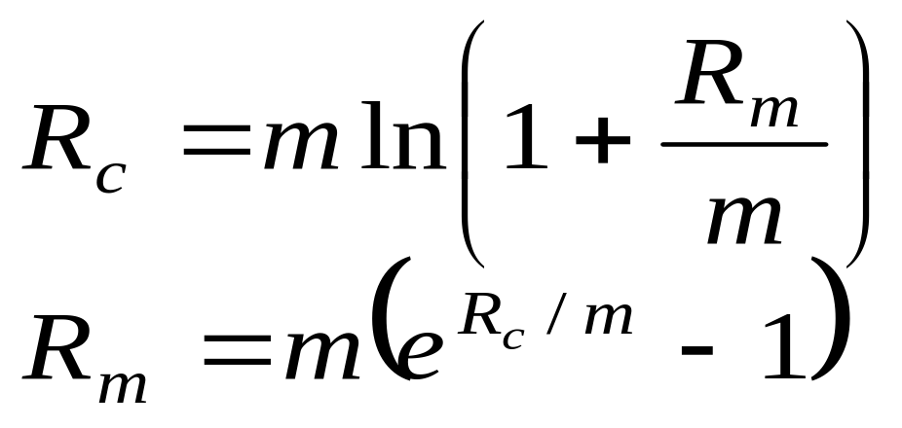
Conversion Formulas
(Page 87)
Define
R_{c} : continuously compounded rate
R_{m}: same rate with compounding m times per year

Slide 14
Examples
10% with semiannual compounding is equivalent to 2ln(1.05)=9.758% with continuous compounding
8% with continuous compounding is equivalent to 4(e^{0.08/4} -1)=8.08% with quarterly compounding
Rates used in option pricing are usually expressed with continuous compounding

Slide 15
Zero Rates
A zero rate (or spot rate), for maturity T is the rate of interest earned on an investment that provides a payoff only at time T

Slide 16
Example (Table 4.2, page 88)
Maturity (years) | Zero rate (cont. comp.
0.5 | 5.0
1.0 | 5.8
1.5 | 6.4
2.0 | 6.8

Slide 17
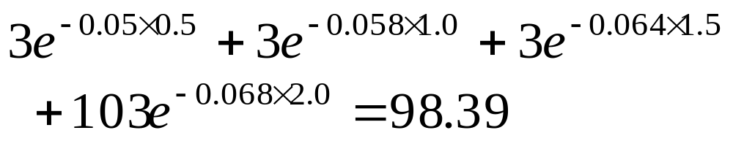
Bond Pricing
To calculate the cash price of a bond we discount each cash flow at the appropriate zero rate
In our example, the theoretical price of a two-year bond providing a 6% coupon semiannually is

Slide 18
Bond Yield
The bond yield is the discount rate that makes the present value of the cash flows on the bond equal to the market price of the bond
Suppose that the market price of the bond in our example equals its theoretical price of 98.39
The bond yield is given by solving
to get y = 0.0676 or 6.76% (cont. comp.)

Slide 19
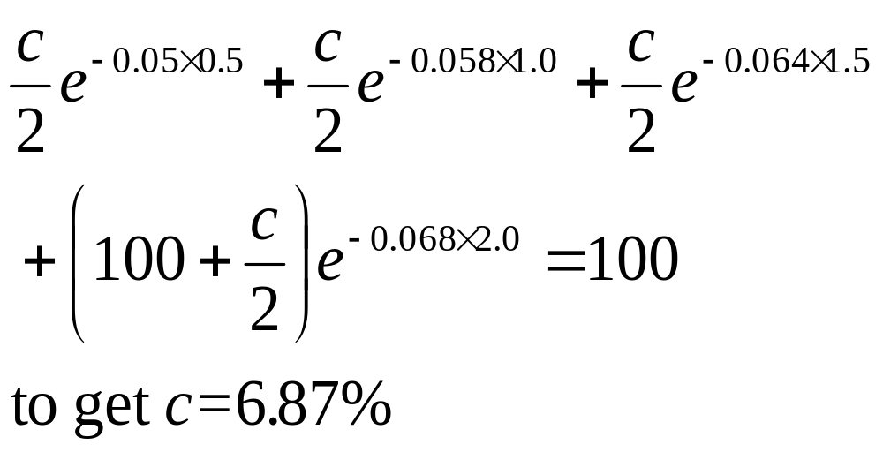
Par Yield
The par yield for a certain maturity is the coupon rate that causes the bond price to equal its face value.
In our example we solve

Slide 20
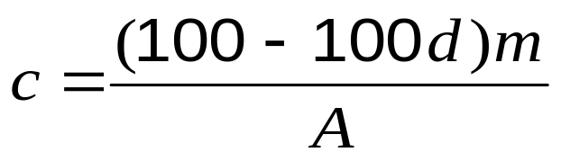
Par Yield continued
In general if m is the number of coupon payments per year, d is the present value of $1 received at maturity and A is the present value of an annuity of $1 on each coupon date
(in our example, m = 2, d = 0.87284, and A = 3.70027)

Slide 21
Data to Determine Treasury Zero Curve (Table 4.3, page 90)
Bond Principal | Time to Maturity (yrs) | Coupon per year ($)* | Bond price ($)
100 | 0.25 | 0 | 97.5
100 | 0.50 | 0 | 94.9
100 | 1.00 | 0 | 90.0
100 | 1.50 | 8 | 96.0
100 | 2.00 | 12 | 101.6
* Half the stated coupon is paid each year

Slide 22
The Bootstrap Method
An amount 2.5 can be earned on 97.5 during 3 months.
The 3-month rate is 4 times 2.5/97.5 or 10.256% with quarterly compounding
This is 10.127% with continuous compounding
Similarly the 6 month and 1 year rates are 10.469% and 10.536% with continuous compounding

Slide 23
The Bootstrap Method continued
To calculate the 1.5 year rate we solve
to get R = 0.10681 or 10.681%
Similarly the two-year rate is 10.808%

Slide 24
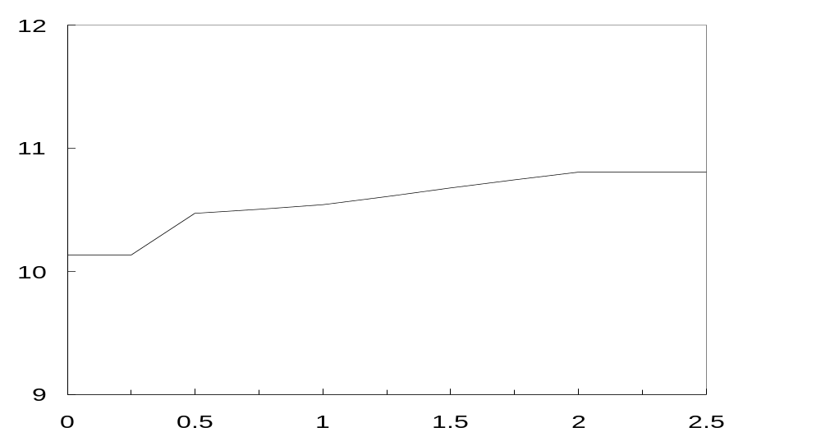
Zero Curve Calculated from the Data (Figure 4.1, page 91)
Zero Rate (%)
10.681
10.808
10.469
10.536
10.127
Maturity (yrs)

Slide 25
Application to OIS Rates
OIS rates out to 1 year are zero rates
OIS rates beyond one year are par yields,

Slide 26
Forward Rates
The forward rate is the future zero rate implied by today’s term structure of interest rates

Slide 27
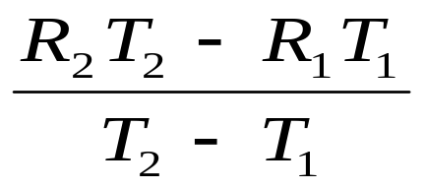
Formula for Forward Rates
Suppose that the zero rates for time periods T₁ and T₂ are R₁ and R₂ with both rates continuously compounded.
The forward rate for the period between times T₁ and T₂ is
This formula is only approximately true when rates are not expressed with continuous compounding

Slide 28
Application of the Formula
Year (n) | Zero rate for n-year investment (% per annum) | Forward rate for nth year (% per annum)
1 | 3.0
2 | 4.0 | 5.0
3 | 4.6 | 5.8
4 | 5.0 | 6.2
5 | 5.5 | 6.5

Slide 29
Upward vs Downward Sloping
Yield Curve
For an upward sloping yield curve:
Fwd Rate > Zero Rate > Par Yield
For a downward sloping yield curve
Par Yield > Zero Rate > Fwd Rate

Slide 30
Forward Rate Agreement
A forward rate agreement (FRA) is an OTC agreement that a certain LIBOR rate will apply to a certain principal during a certain future time period

Slide 31
Forward Rate Agreement: Key Results
An FRA is equivalent to an agreement where interest at a predetermined rate, R_{K} is exchanged for interest at the LIBOR rate
An FRA can be valued by assuming that the forward LIBOR interest rate, R_{F} , is certain to be realized
This means that the value of an FRA is the present value of the difference between the interest that would be paid at interest rate R_{F} and the interest that would be paid at rate R_{K}

Slide 32
FRA Example
A company has agreed that it will receive 4% on $100 million for 3 months starting in 3 years
The forward rate for the period between 3 and 3.25 years is 3%
The value of the contract to the company is +$250,000 discounted from time 3.25 years to time zero at the OIS rate

Slide 33
FRA Example Continued
Suppose rate proves to be 4.5% (with quarterly compounding
The payoff is –$125,000 at the 3.25 year point
Often the FRA is settled at tiem 3 years for the present value of the known cash flow at time 3.25 years.

Slide 34
Theories of the Term Structure
Pages 97-98
Expectations Theory: forward rates equal expected future zero rates
Market Segmentation: short, medium and long rates determined independently of each other
Liquidity Preference Theory: forward rates higher than expected future zero rates

Slide 35
Liquidity Preference Theory
Suppose that the outlook for rates is flat and you have been offered the following choices
What would you choose as a depositor? What for your mortgage?
Maturity | Deposit rate | Mortgage rate
1 year | 3% | 6%
5 year | 3% | 6%

Slide 36
Liquidity Preference Theory cont
To match the maturities of borrowers and lenders a bank has to increase long rates above expected future short rates
In our example the bank might offer
Maturity | Deposit rate | Mortgage rate
1 year | 3% | 6%
5 year | 4% | 7%

